Slide 1
Our Great State Association
The Beekeepers of Indiana
thebeekeepersofindiana.com

Slide 2

Different Organizational Levels
Local Clubs
State Associations
Regional Societies
National Federation
International

Slide 3
What is TBoI?
The Beekeepers of Indiana
Over 1800 Beekeepers Strong
Members in 13 States
Sponsor Four Major Events a Year
  Indiana Bee School
  Purdue Field Day
  Indiana State Fair
  Fall Conference and Workshops
Belong to Regional and National Associations

Slide 4
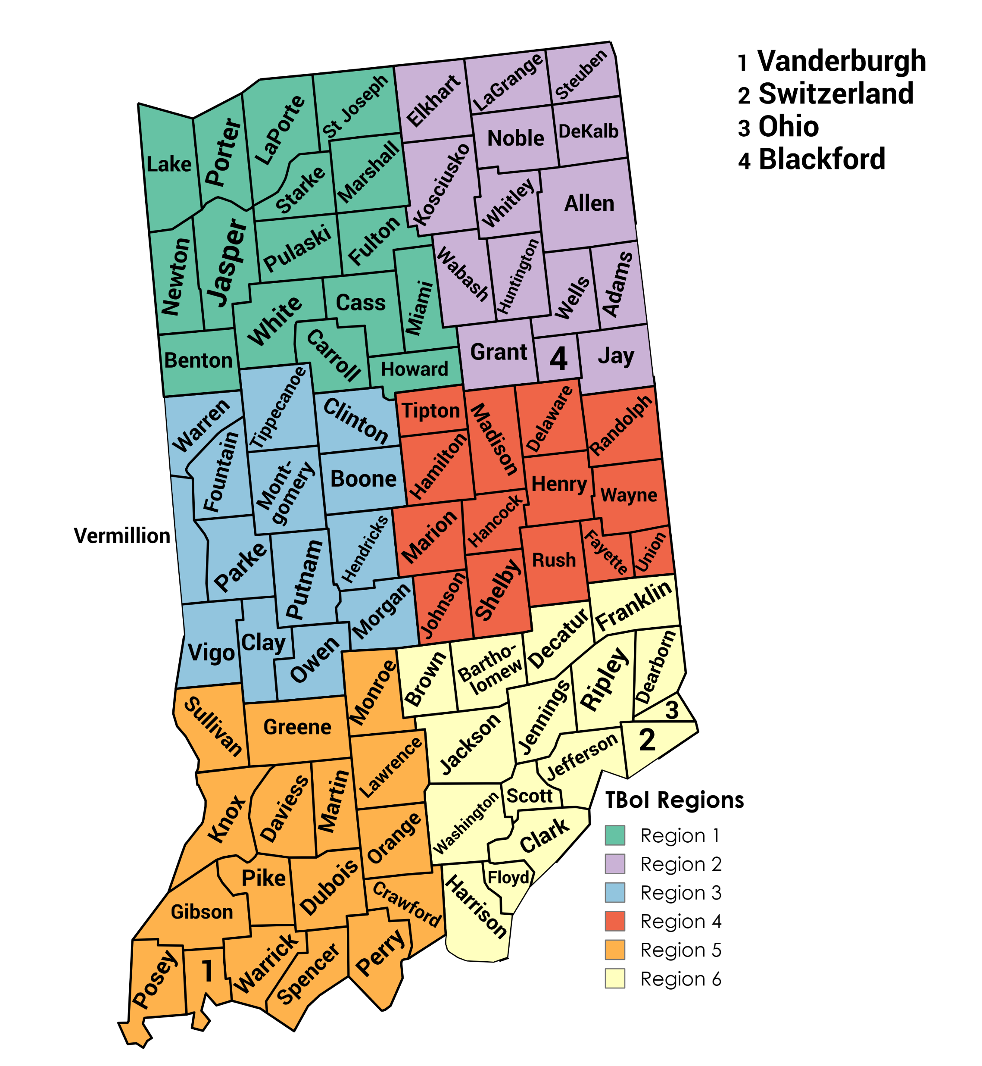
32 Established Clubs
Access to Jump Starter Program
Access to Speakers
Articles in the Newsletter
Advertising on website
Club Website
New Member Information
Right manage booth at the Indiana State Fair
- Daily Tickets for Volunteers
- Make money for the club

Slide 5
The Beekeepers of Indiana
Quarterly Board Meetings
  Indianapolis International Airport
    7800 Col H Weir Cook Mem Dr
    Indianapolis, IN 46241
Officers/Board of Directors
Set Dues
Bee School
  Renowned Guest Speakers
State Fair Participation
Queen Breeding Program

Slide 6
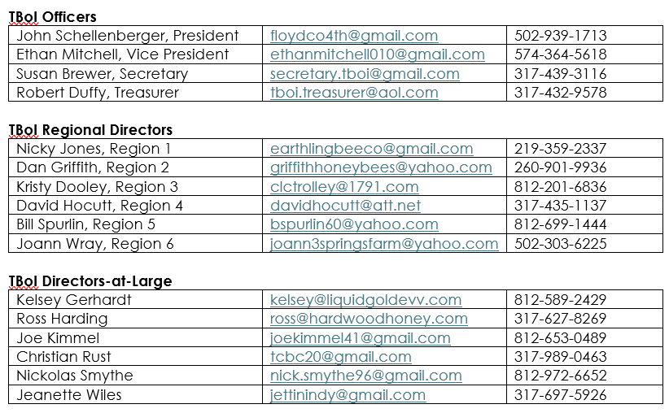
TBoI Executive Board

Slide 7
The Beekeepers of Indiana
Young Beekeeper Award Program
Indiana Honey Queen Program
Jump Starter Program
Quarterly Newsletters
  Local Club Articles
Swarm/Cut Out Lists
Local Honey Lists
New Initiatives
  Beekeeping legislation for municipalities/HOAs
  $1,500 Tax Free Purchase
  $1,500 Income Exempt

Slide 8
Questions?

